Slide 1
Data Mining Analysis of Climate Variability in South Texas
Juliann Booth & Nina Culver
Assisted by Dr. Kartik Venkataraman & Dr. Jesse Crawford

Slide 2
Overview
Summary of Research
About the Data
Preliminary Analysis
Trend analysis
Model analysis
On-Going Efforts

Slide 3
Our Research

Slide 4
Climate Variability
Future uncertainties of water availability in Texas
Availability of Global Climate Change models
Notes:
Add the sponsored by here,
Use these models to project downscaled climate trends (specifically, South Texas)
impacts on the future of water in Texas

Slide 5
Goals of Project
Assess model reliability
Identify global models (or combinations thereof) that are best able to replicate historical regional data
Evaluate future projections given by best models
Make recommendations to water planners on model applicability

Slide 6
Data Mining
Large scale spatial and temporal data
Total data involved is about 1 GB
Requires knowledge of predictive modeling, trend analysis, and reliability

Slide 7
The Data

Slide 8
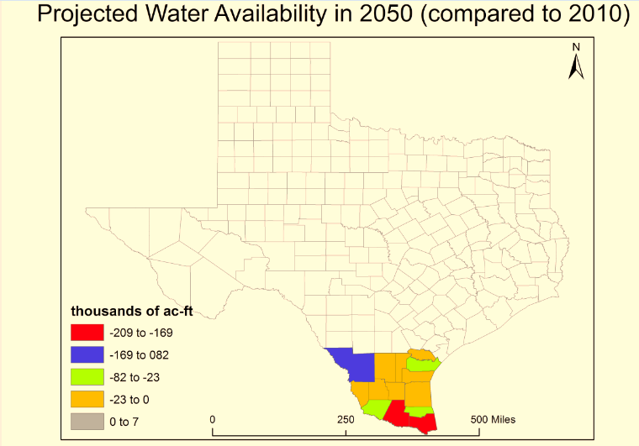
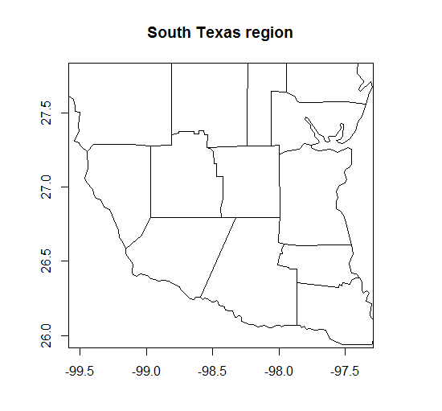
Our Region
Notes:
This region will be stressed for water because of the growing population, the eagle forge shale fracking uses tons of water. How will the availability of water change? ***NEW FIGURE
Explain that CMIP5 is sponsored by,

Slide 9
The Observed Data
Compiled by the World Climate Research Programme (WCRP)
Average monthly precipitation (mm) and temperature (°C) from January 1950 - December 1999
Two 19 x 16 x 600 data sets
Notes:
WCRP = world climate research programme

Slide 10

The Projection Data
34 CMIP5 Models from distinguished research institutions around the world
Australia, China, USA, UK, France, Italy, Japan, South Korea, Russia, Germany, Norway
Two 19 x 16 x 600 x 34 datasets →
Two 177,601 x 37 datasets (after deleting N/A data)
Notes:
NCAR - National Center for Atmospheric Research
Question...where is the observed data from?

Slide 11
Preliminary Analysis
Mann Kendall Test for Trend

Slide 12
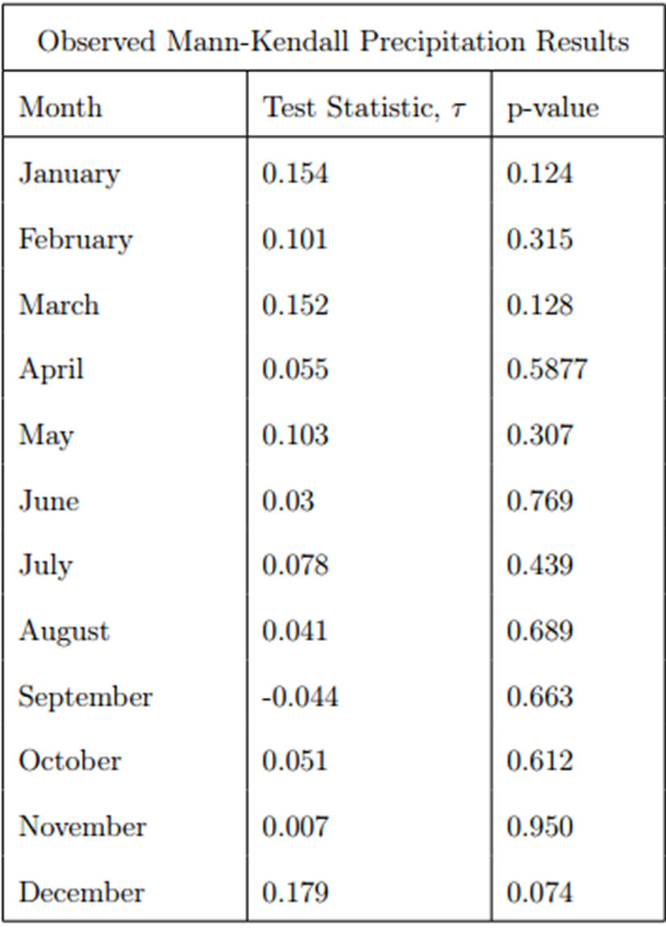
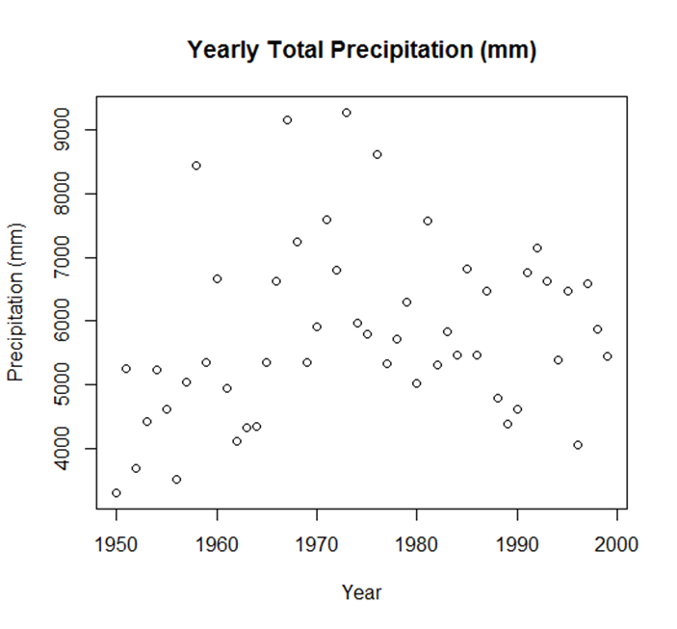
Precipitation Trend
two-sided p-value = 0.056, tau = 0.187
Notes:
chart of p-values even

Slide 13
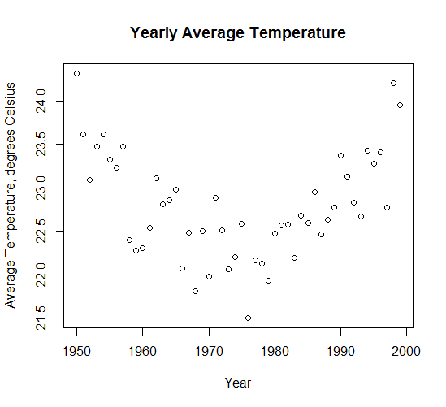
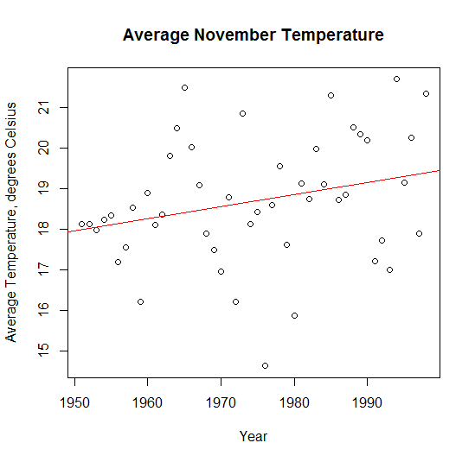
Temperature Trend
two-sided p-value = 0.72535, tau = 0.0351
two-sided p-value = 0.03636, tau = 0.209
Notes:
chart of p-values even

Slide 14
Preliminary Analysis
Model Visualizations

Slide 15
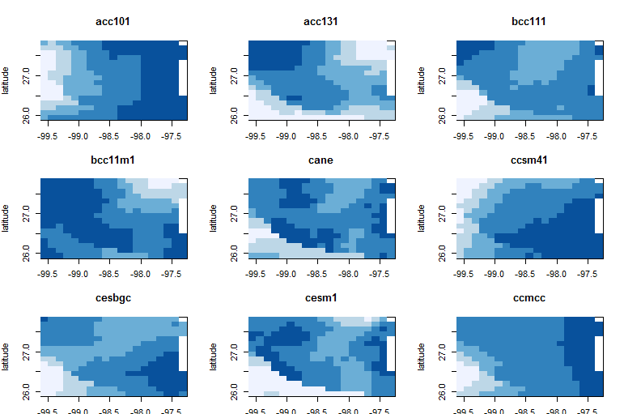
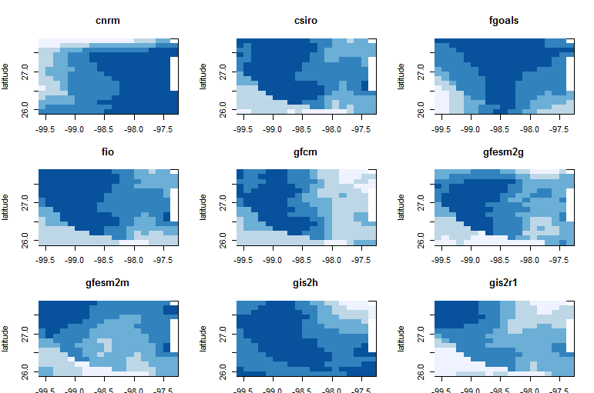
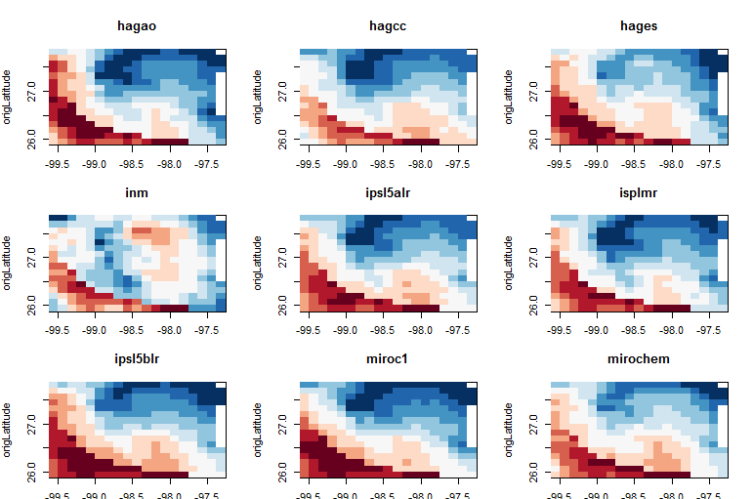
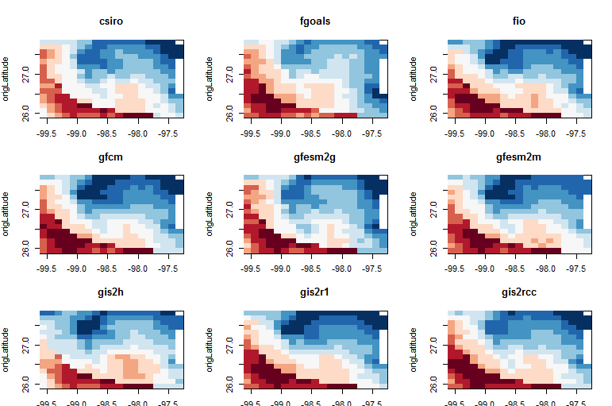
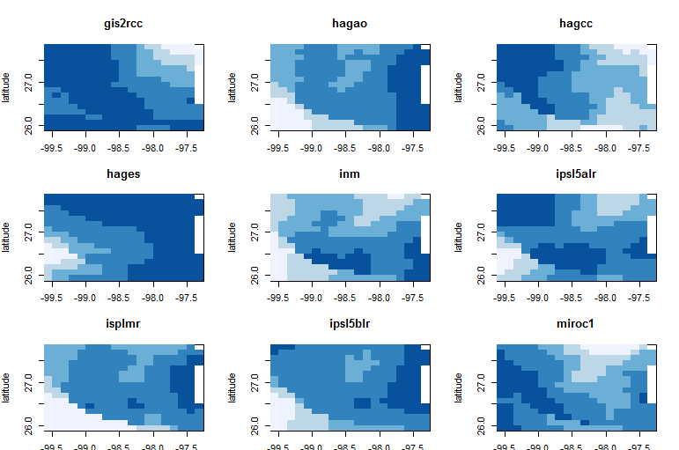
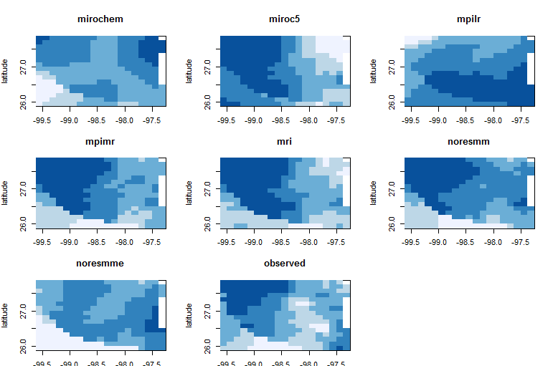
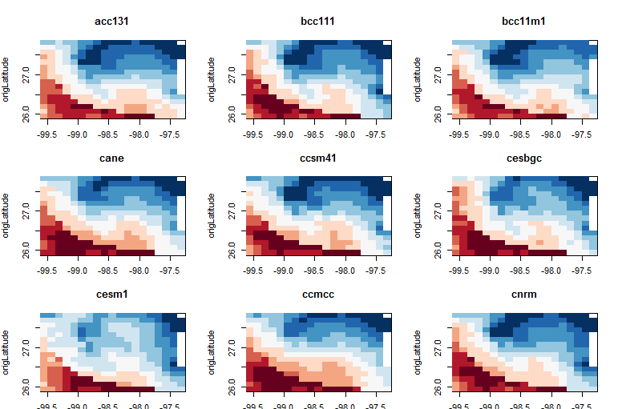
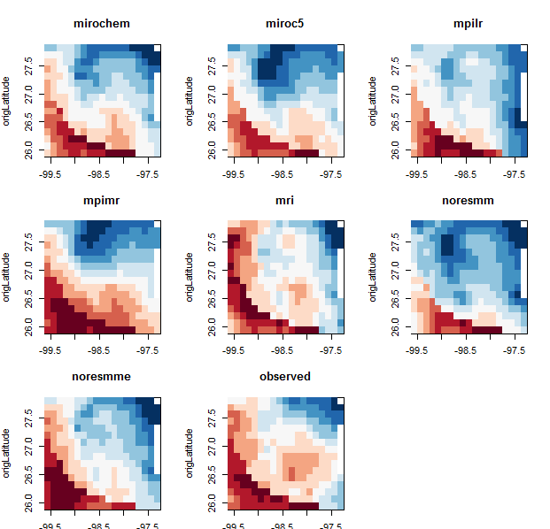
Precipitation
Temperature

Slide 16
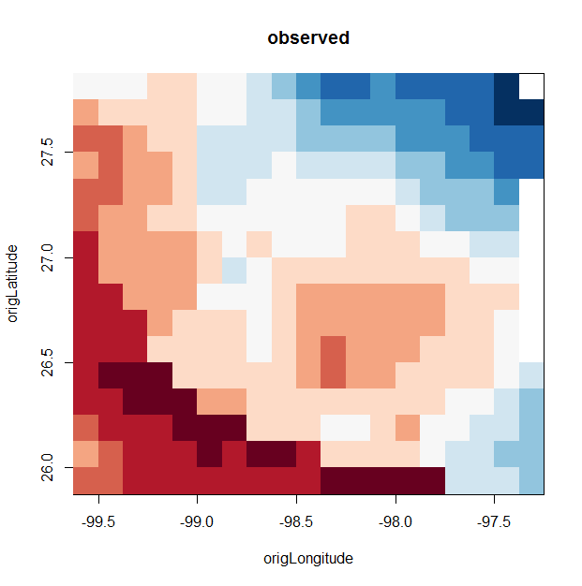
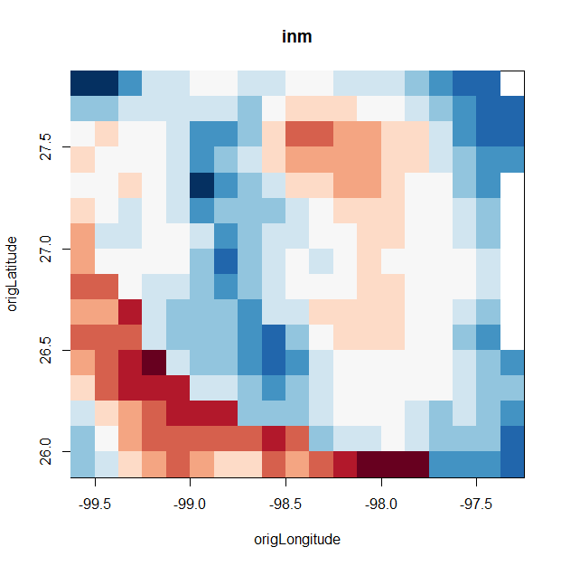
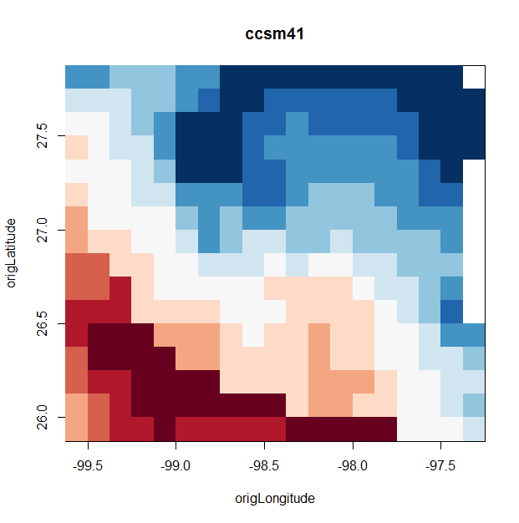
Institute for Numerical Mathematics, Moscow, Russia
National Center for Atmospheric Research,
Boulder, CO
Notes:
reliability
change labels to be just “longitude” and “latitude”

Slide 17
On-Going Efforts

Slide 18
Analyzing Temperature Trend
Expand research on the nonlinear yearly temperature trend

Slide 19
Find Most Predictive Models
Use techniques such as Bayesian Model Averaging and Random Forests to find a reliable model of South Texas climate
Analyze projections provided by the combination of best models
Notes:
Value added by using data mining in this project,

Slide 20
Acknowledgements
“We acknowledge the World Climate Research Programme's Working Group on Coupled Modelling, which is responsible for CMIP, and we thank the climate modeling groups for producing and making available their model output. For CMIP the U.S. Department of Energy's Program for Climate Model Diagnosis and Intercomparison provides coordinating support and led development of software infrastructure in partnership with the Global Organization for Earth System Science Portals.”

Slide 21
References
Mann, H.B. (1945), Nonparametric tests against trend. Econometrica, 13.
245-259.
RStudio Team (2015). RStudio: Integrated Development for R. RStudio,
Inc., Boston, MA
TXS Image. (n.d.). Retrieved November 29, 2015, from
http://www.geomart.com/images/raisedrelief
WCRP Coupled Model Intercomparison Project – Phase 5: Special
Issue of the CLIVAR Exchanges Newsletter, No. 56, Vol. 15, No. 2

Slide 22
THANK YOU!

